Slide 1
SEE SENSE
TEAM JUGAAD JUNCTION
Hold the button. Say where you want to go. Get guided there.
A wearable indoor guide for blind people · Claude Impact Lab - Superhuman Lab hackathon
Notes:
We built a wearable that guides a blind person to a place they can't see (a door, the exit, a seat) one step at a time.

Slide 2
Every new room is a puzzle
02 · THE PROBLEM
A cane finds what's at your feet, not where the door is
GPS doesn't work indoors
Description apps say "there's a door", not how to reach it
A phone needs a free hand, and the cane already has one
Notes:
Imagine walking into a classroom you've never seen and needing the way out. A white cane tells you about the chair leg in front of you. It can't tell you the door is behind you on the right, past three tables. Today, the answer is: ask someone.

Slide 3
Blind and low-vision people who get around on their own
03 · WHO IT'S FOR
Independent
Indoors, unfamiliar
One moment
They already move on their own with a white cane
Colleges, offices, hospitals, stations, shops
"Where is it, and how do I get there?"
Notes:
Our users don't need a device that talks all the time: their hearing tells them about the room. They need help at the moment of "where is it?"

Slide 4
A guide that looks, plans and walks you there
04 · THE SOLUTION
1
2
3
Hold the button
It looks around
It plans the walkway
"Take me to the exit"
"Turn right about 90 degrees." … "OK, stop."
"Walk about 3 steps. The tables will be on your left."
4
5
6
It warns only when it matters
It clears the way
You arrive
"A person on your left, coming toward you."
"The chair is right in front of you. Push it to your left."
"The door is right in front of you. The handle is on the right."
Notes:
Wayfinder works like a sighted friend: it looks around first, finds the nearest door, works out how far the way is clear, and if a chair is blocking it, tells you how to move it. Press the button for the next step. Every two steps, it looks again. Along the way it doesn't talk about everything it sees: only what you need, like someone walking toward you. (It measures your turn from the camera.)

Slide 5
Claude sees. JEV decides fast. You hear only what matters.
05 · HOW IT WORKS
Part | Job
Head camera | Claude's eyes; also measures your turn, to about 1°
Claude Sonnet 5.5 | Understands the room, picks the nearest door, plans the route
JEV (TypeSafe) | In 0.3 s: request, command or misheard? What needs a warning?
Button + Vosk | Hold to speak, press for the next step; speech recognised offline
Earbuds | Every instruction in a natural voice, stored on the device
Live view | A helper, trainer or judge sees what Wayfinder sees, in any browser
Notes:
Two AIs, each doing what it's best at. Claude does the hard thinking: understanding the room and planning. JEV makes quick decisions in a third of a second: if the microphone misheard you, it says so at once instead of spending a slow Claude look; and it decides which things are worth a warning, so the device stays quiet. The voice is ElevenLabs, recorded once and stored on the device. The device itself is a Raspberry Pi with no AI models on it.

Slide 6
Built around how blind people actually move
06 · DESIGN PRINCIPLES
Quiet by default
Only instructions and real warnings are spoken
Survey before planning
Finds the nearest door, and checks another angle before calling the way blocked
Hands free
One button, no phone in hand
Honest
Says when it's unsure; never says a path is "safe"
Respectful
Never asks you to move a person or someone's wheelchair
Notes:
Blind people use their hearing to understand a room: footsteps, voices, echoes. So Wayfinder only speaks when it has something you need.

Slide 7
Simple hardware; the intelligence is in the cloud
07 · WHAT IT'S BUILT FROM
Hardware
Software
73 MB
Raspberry Pi 5 + Active Cooler
Claude Sonnet 5.5: seeing and planning
Pi Camera 3 on the chest
JEV (TypeSafe): quick decisions
Device software, no AI models on the device
INMP441 microphone
Vosk: offline speech recognition
Push button
ElevenLabs voice; espeak-ng backup
~$0.01–0.02
Bluetooth earbuds
OpenCV: measures turns
Power bank/Supply
Python, picamera2, gpiozero, systemd
Per Claude look (estimate)
Notes:
The wearable is a Raspberry Pi with a camera, a microphone and one button. It sends a photo to Claude when it needs to look, and keeps everything else on the device. Each Claude look measured about 2,900–4,300 tokens in and 140–190 out.

Slide 8
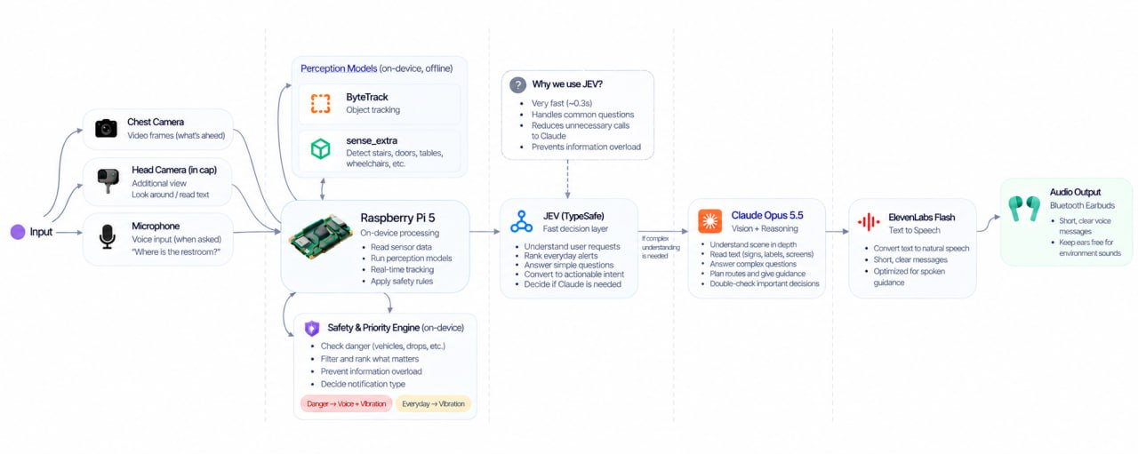
08 · HOW IT WORKS

Slide 9
Built, tested, and running on the hardware
09 · RESULTS AND LIMITS
4.5 s
3.1 s
0.3 s
First answer
Re-checks
JEV decisions
Proven
Limits
Still open
Found a glass door past tables in live tests
Needs internet; indoors only; distances are estimates
Not yet tested with blind users
Runs on the Raspberry Pi 5 in a real classroom
Use it with the cane, not instead of it
Notes:
We're honest about what's proven. The software works, it runs on the hardware, and we've measured the timing. A survey with one turn takes 8 seconds plus turning time. JEV catches misheard speech and commands said another way ("what do I do now" = next step, "cancel that" = stop). On the Pi it understood "go to the bathroom" and found an open glass door. On the Pi's first run, answers took 6 to 29 seconds, so we made the pictures smaller and added a "Still looking" message. What we haven't done yet is the most important part: testing with blind users.

Slide 10
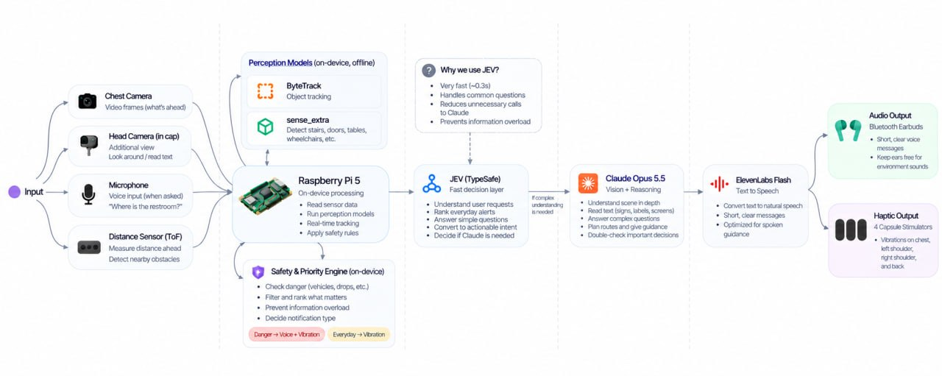
10 · FUTURE SCOPE

Slide 11
Thank You!
Team Jugaad Junction
Deepraj R · Hadi Afnan · Mohammed Anshid · Aflah Sidhique
Notes:
We don't give you eyes. We give you another way to find your way. We're looking for people to test it with. Thank you.

